Slide 1
Spring Boot - DevOps Tools

Slide 2
Objectives
DevOps
Spring Boot with DevOps
DevOps Tools for Spring Boot

Slide 3
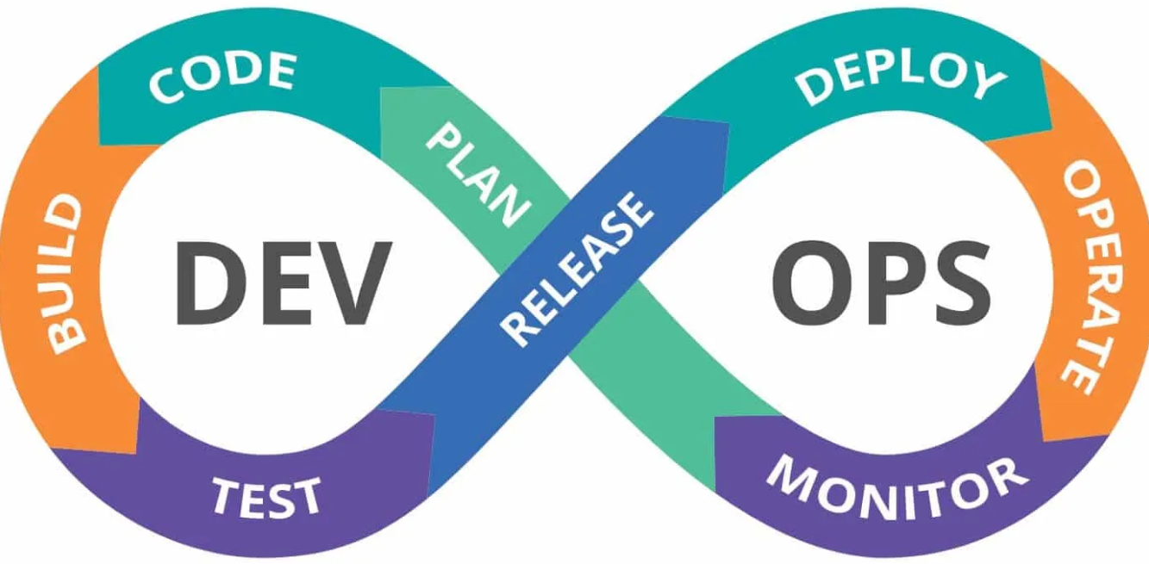
DevOps
DevOps is the practice that encourages communication, collaboration, integration, and automation between software development and operations teams.

Slide 4
Why Spring Boot for DevOps? - 1
Microservice friendly: Easy to create and deploy small, independent services.
Fast startup: Embedded servers and optimized dependencies reduce startup time.
Efficient deployment: Build self-contained JARs or WARs for easy deployment.
Monitoring & management: Built-in support for health checks and metrics.
Cloud-Native: Seamless integration with cloud platforms (e.g., Cloud Foundry, Kubernetes).

Slide 5
Why Spring Boot for DevOps? - 2
Spring Boot is a fantastic framework for building microservices and web applications due to its ease of use and powerful features.
DevOps practices help teams deliver software faster and more reliably.
By combining Spring Boot with DevOps, you can achieve continuous delivery and deployment of your applications.

Slide 6
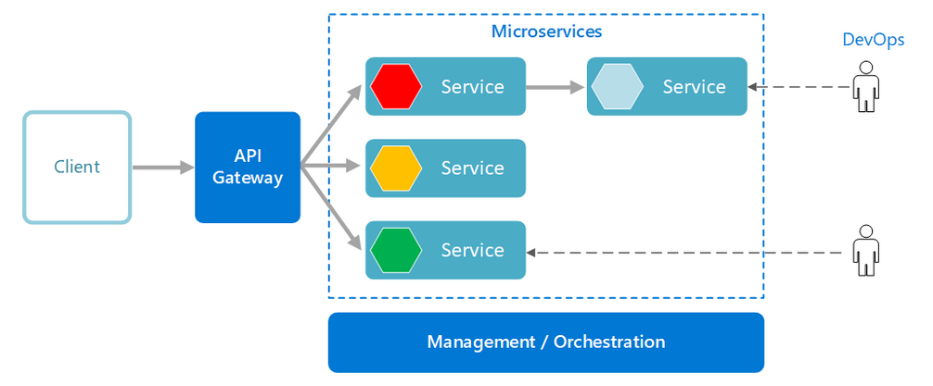
Microservices with DevOps
Notes:
Image Source: docs.microsoft.com

Slide 7
DevOps Tools for Spring Boot
Version control: Git (GitHub, GitLab, Bitbucket)
Continuous integration: Jenkins, GitLab CI/CD, CircleCI
Continuous delivery: Spinnaker, Argo CD
Configuration management: Ansible, Puppet, Chef
Containerization: Docker, Kubernetes
Monitoring: Prometheus, Grafana, ELK Stack

Slide 8
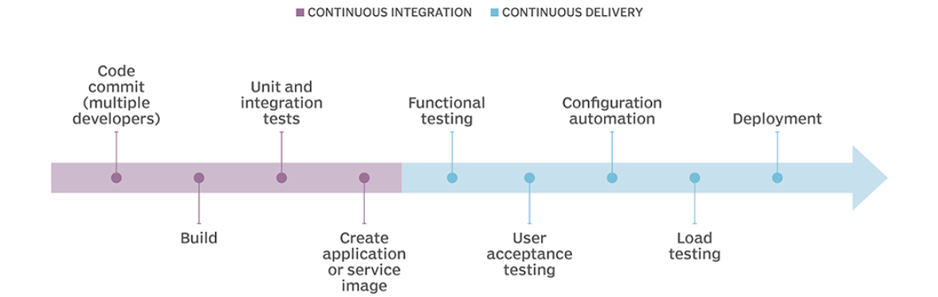
Continuous Integration with Spring Boot
Automated Builds: Trigger builds on code commits.
Unit & Integration Tests: Run tests automatically to ensure quality.
Code Analysis: Use tools like SonarQube for code quality checks.
Artifact Generation: Create deployable JARs/WARs.
Notes:
https://www.techtarget.com/searchsoftwarequality/CI-CD-pipelines-explained-Everything-you-need-to-know

Slide 9
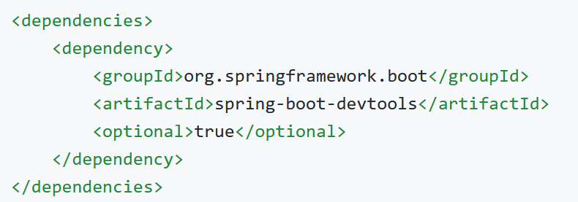
Developer Tools
Spring Boot includes an additional set of tools that can make the application development experience a little more pleasant.
The spring-boot-devtools module can be included in any project to provide additional development-time features.

Slide 10
Spring Boot DevTools features
Property Defaults
Automatic Restart
LiveReload
Remote Debug Tunneling
Remote Update and Restart

Slide 11
Property Defaults

Slide 12
Property Defaults
Property Defaults refer to a set of default property values that are automatically applied during development to enhance the developer experience. These defaults primarily focus on disabling caching mechanisms that are beneficial in production but can hinder rapid development iterations.
Template Engines: Caching of compiled templates (Thymeleaf, Freemarker, Mustache, etc.) is automatically disabled. This ensures that any changes made to your templates are immediately reflected in the running application, without the need for manual cache clearing.
Static Resources: Caching headers for static resources (images, CSS, JavaScript) are typically disabled or set to very short expiration times. This ensures that browsers always fetch the latest versions of these assets, allowing you to see changes instantly.

Slide 13
Key Aspects of Property Defaults
Caching Disabling
Template Engines: Caching of compiled templates (Thymeleaf, Freemarker, etc.) is automatically disabled. This ensures that any changes made to your templates are immediately reflected in the running application, without the need for manual cache clearing.
Static Resources: Caching headers for static resources (images, CSS, JavaScript) are typically disabled or set to very short expiration times. This ensures that browsers always fetch the latest versions of these assets, allowing you to see changes instantly.
Developer-Friendly Configuration
devtools may also modify other properties to improve the development experience, such as enabling debugging features or modifying logging levels.

Slide 14
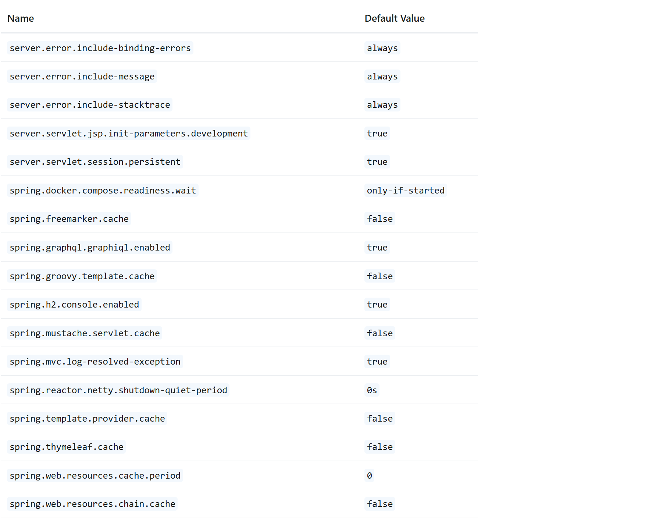
Lists of Property Defaults
Cache options are usually configured by settings in your application.properties file
If you do not want property defaults to be applied you can set spring.devtools.add-properties = false in your application.properties

Slide 15
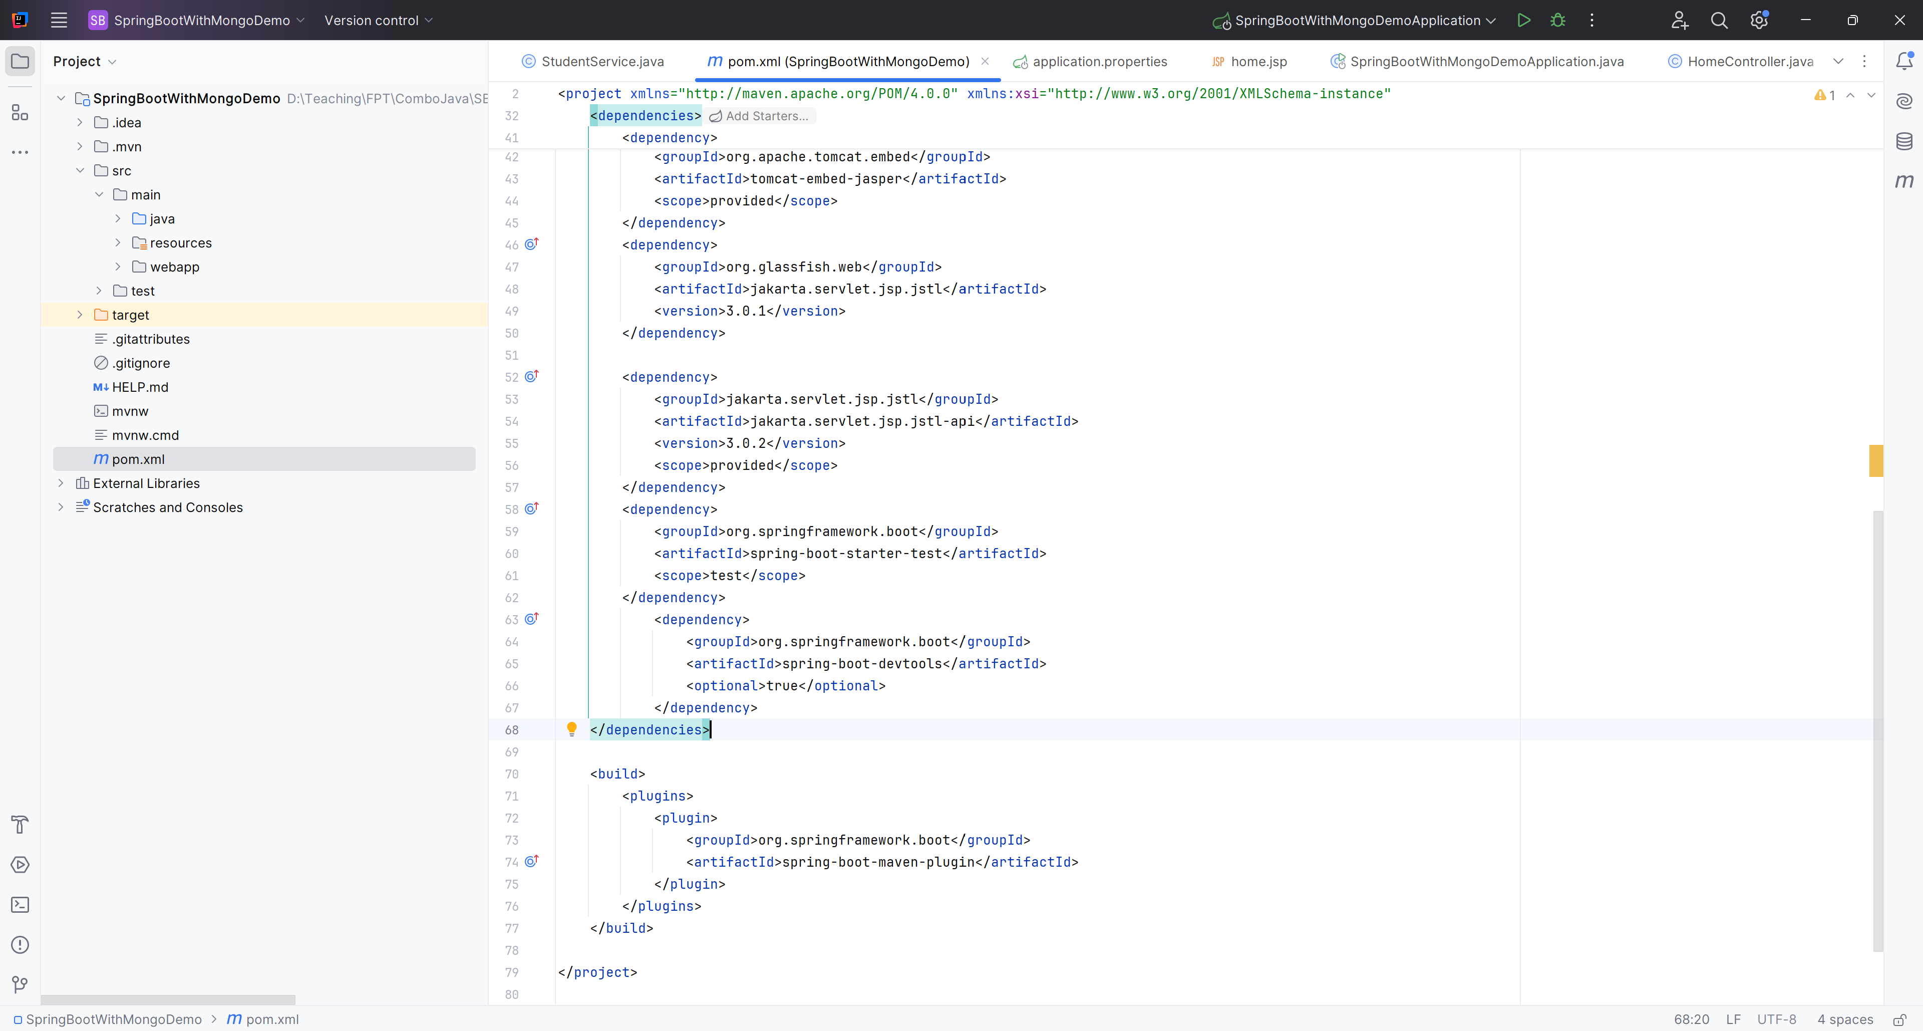
Example

Slide 16
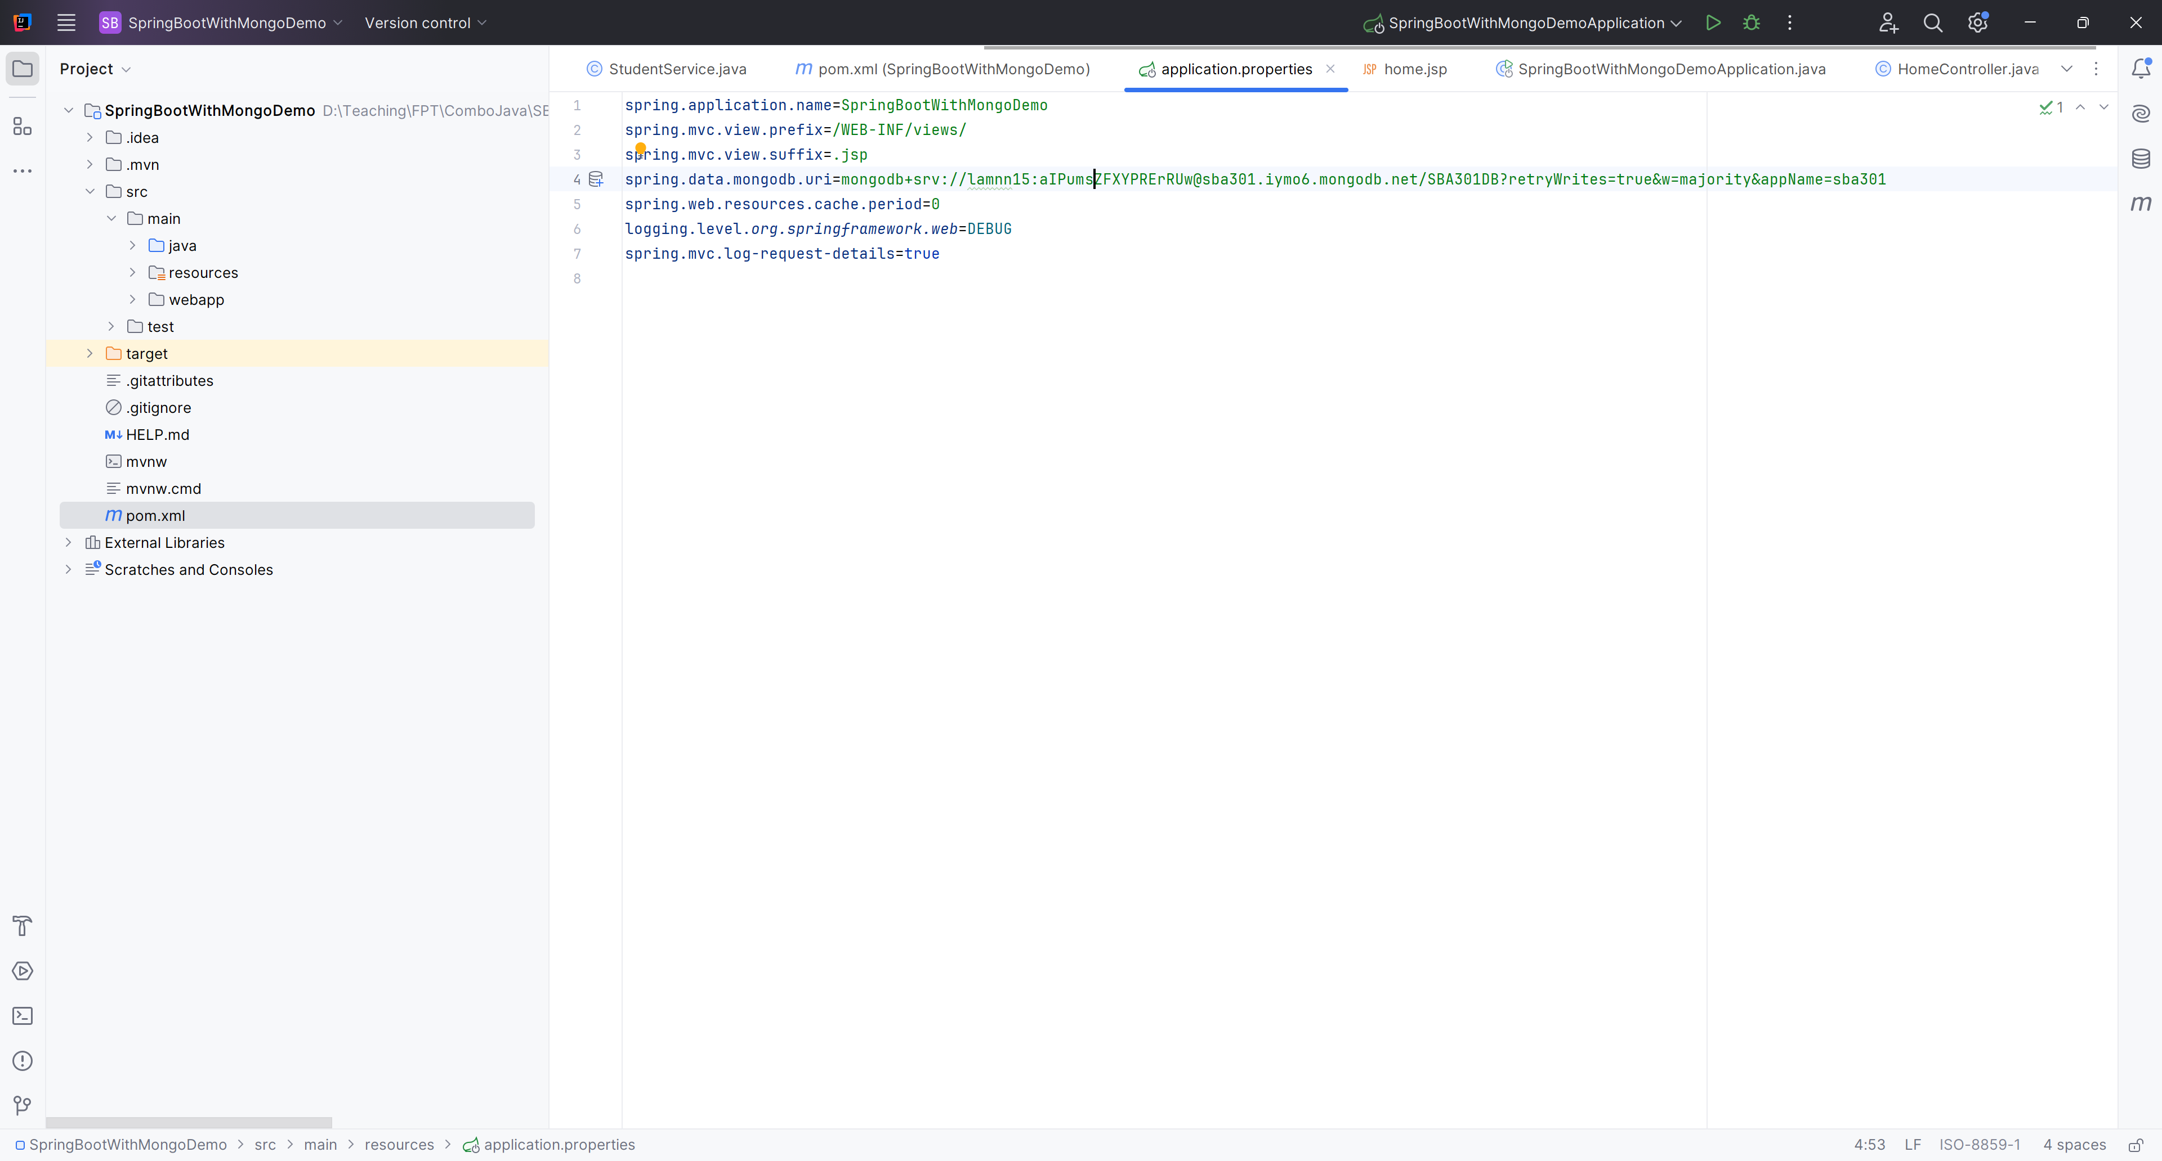
Config

Slide 17
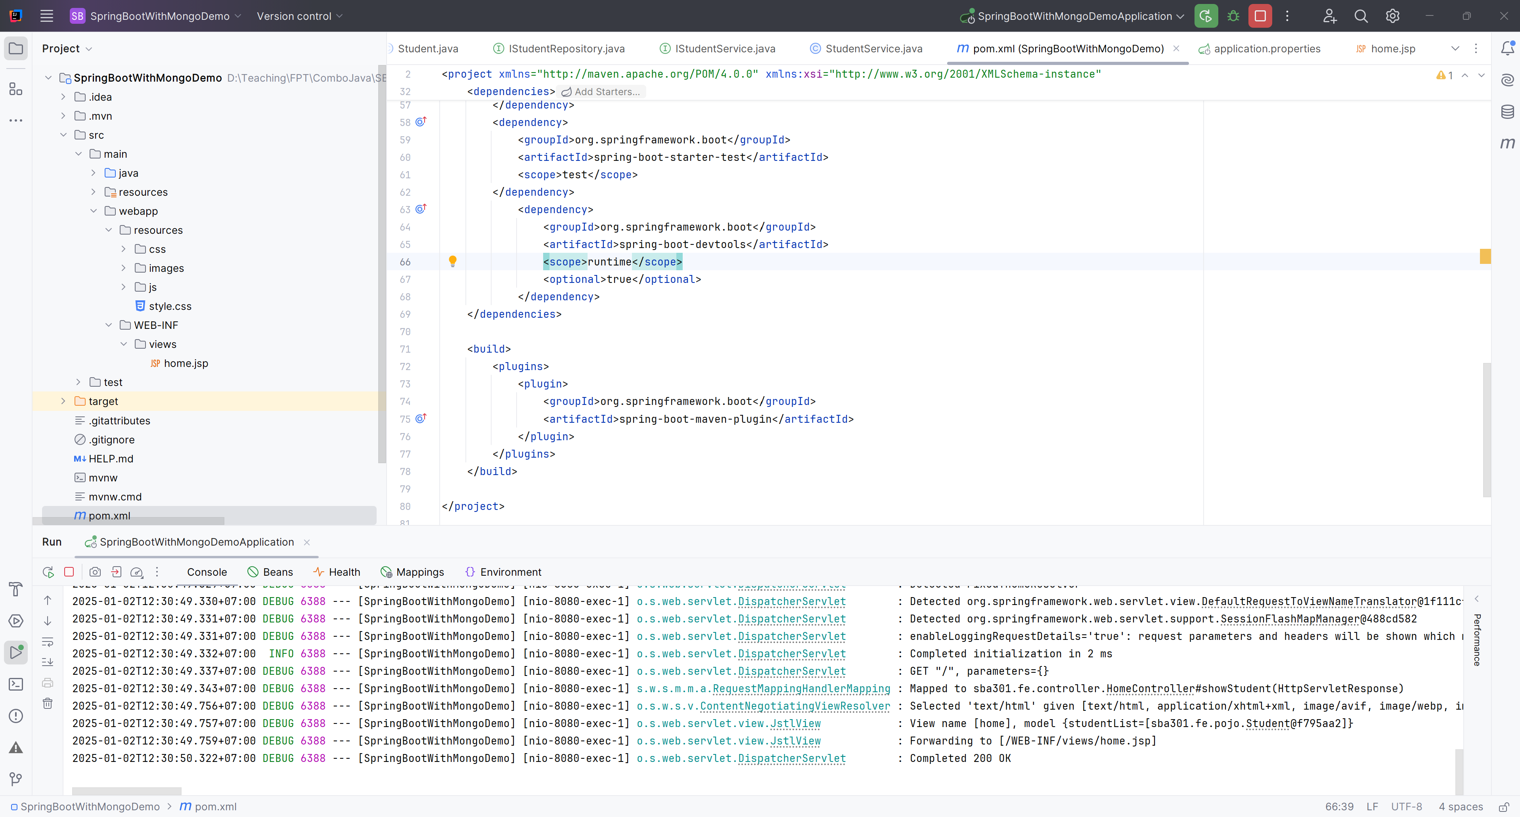
Result

Slide 18
Automatic Restart

Slide 19
Automatic Restart
Applications that use spring-boot-devtools automatically restart whenever files on the classpath change. This can be a useful feature when working in an IDE, as it gives a very fast feedback loop for code changes. By default, any entry on the classpath that points to a directory is monitored for changes.
Automatic restart works very well when used with LiveReload.

Slide 20
Automatic Restart
In Eclipse, saving a modified file causes the classpath to be updated and triggers a restart.
In IntelliJ IDEA, building the project (Build -> Build Project) has the same effect.
If using a build plugin, running mvn compile for Maven or gradle build for Gradle will trigger a restart.

Slide 21
Step-by-Step Guide for Auto-Restart
Step 01 : Add the spring-boot-devtools dependency
Step 02 : Config Settings -> Build, Execute, Deployment -> Complier
Step 03 : Config Advanced Settings

Slide 22
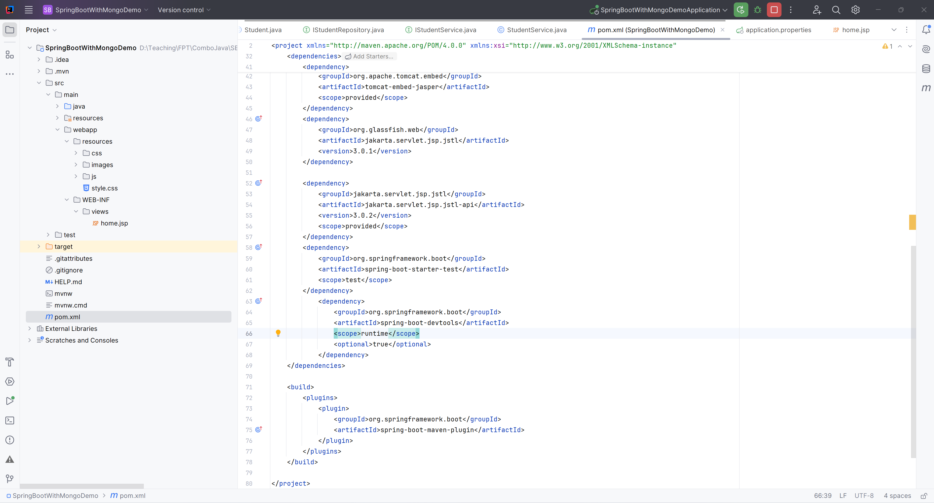
Automatic Restart - Step 01

Slide 23
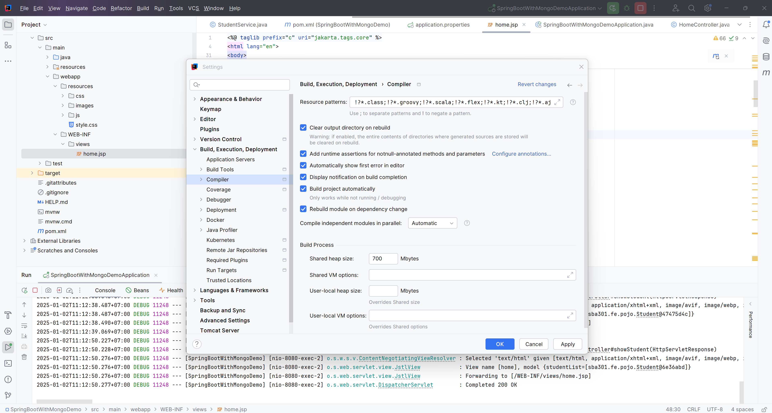
Automatic Restart – Step 02

Slide 24
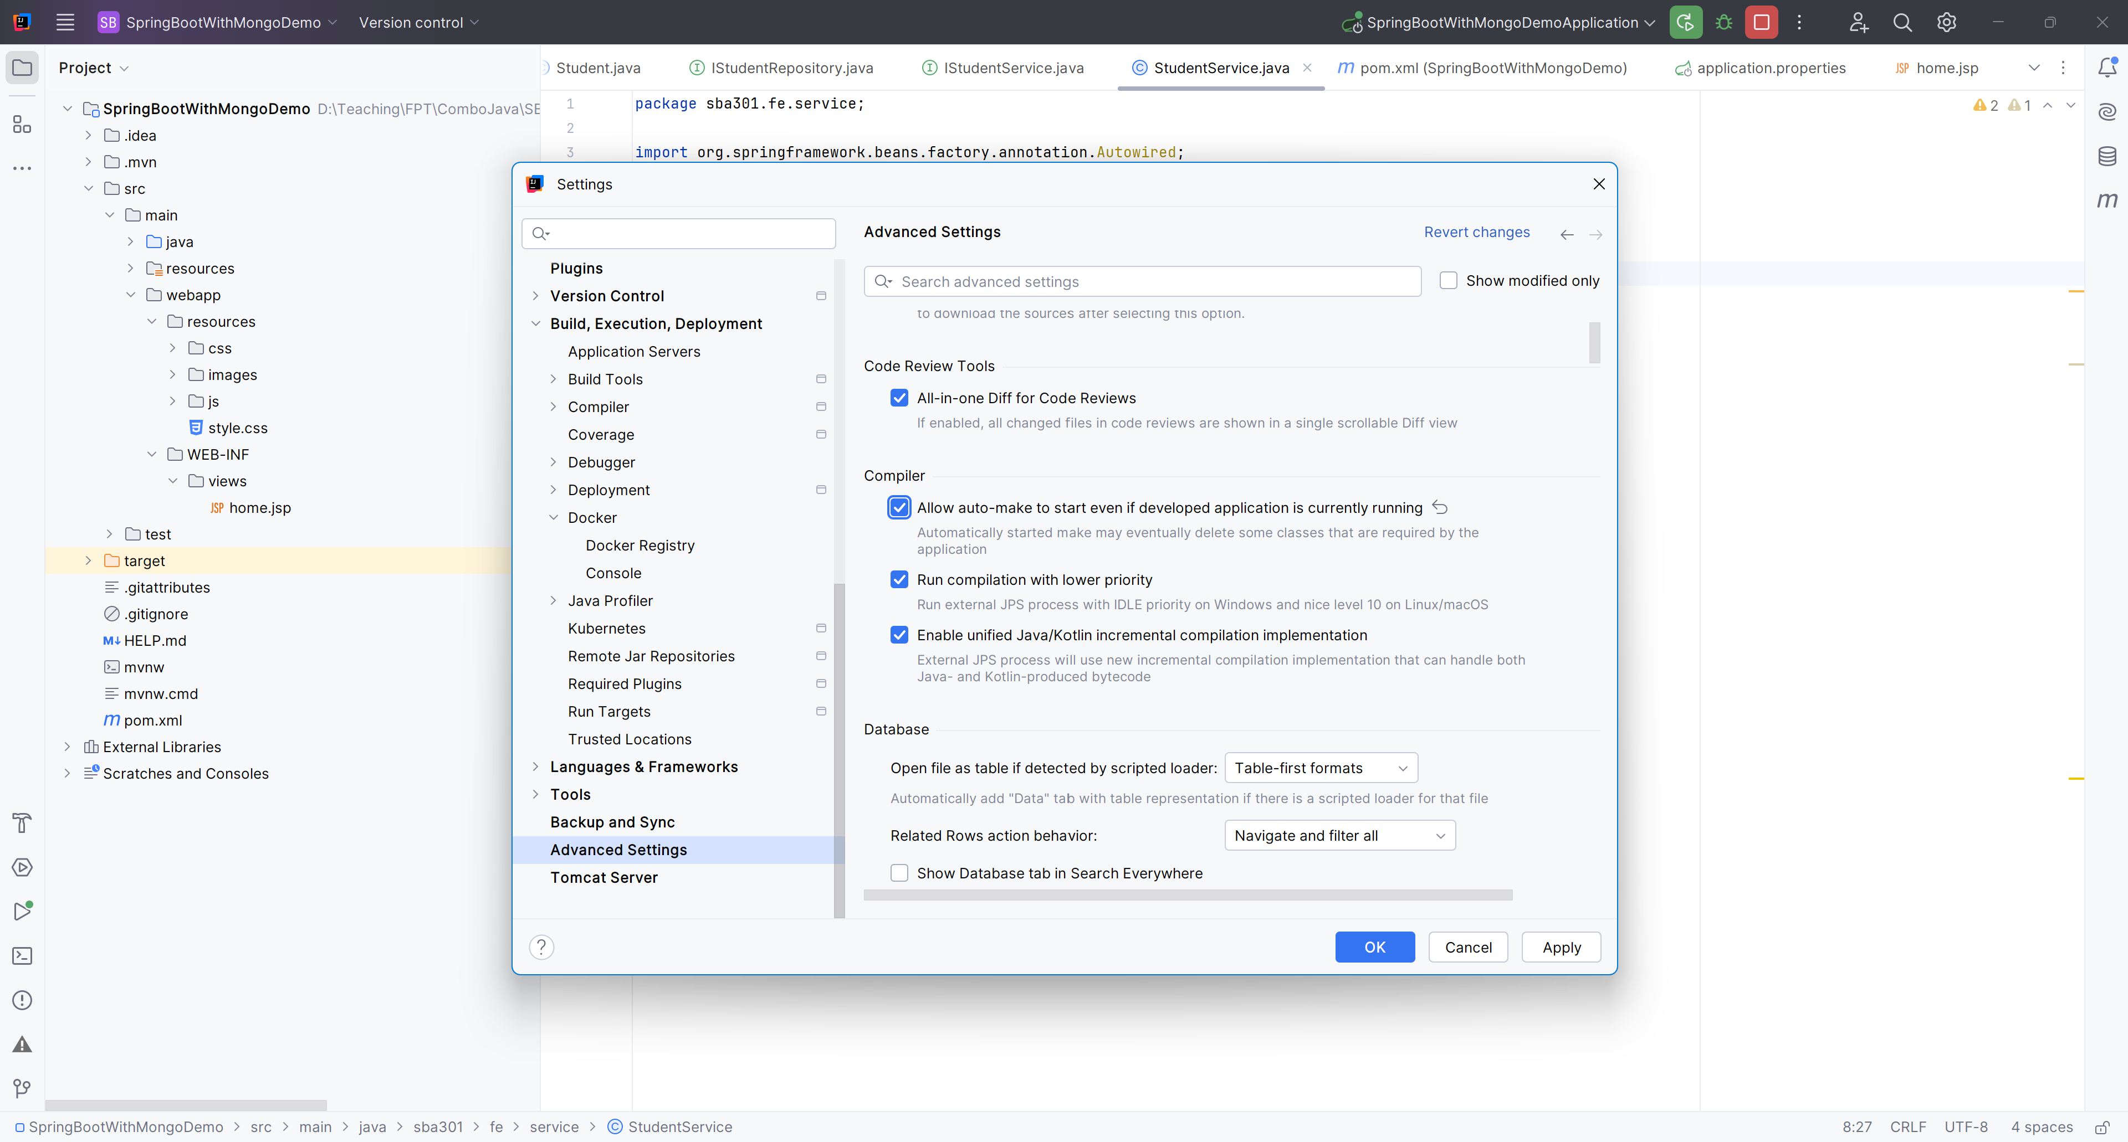
Automatic Restart – Step 03

Slide 25
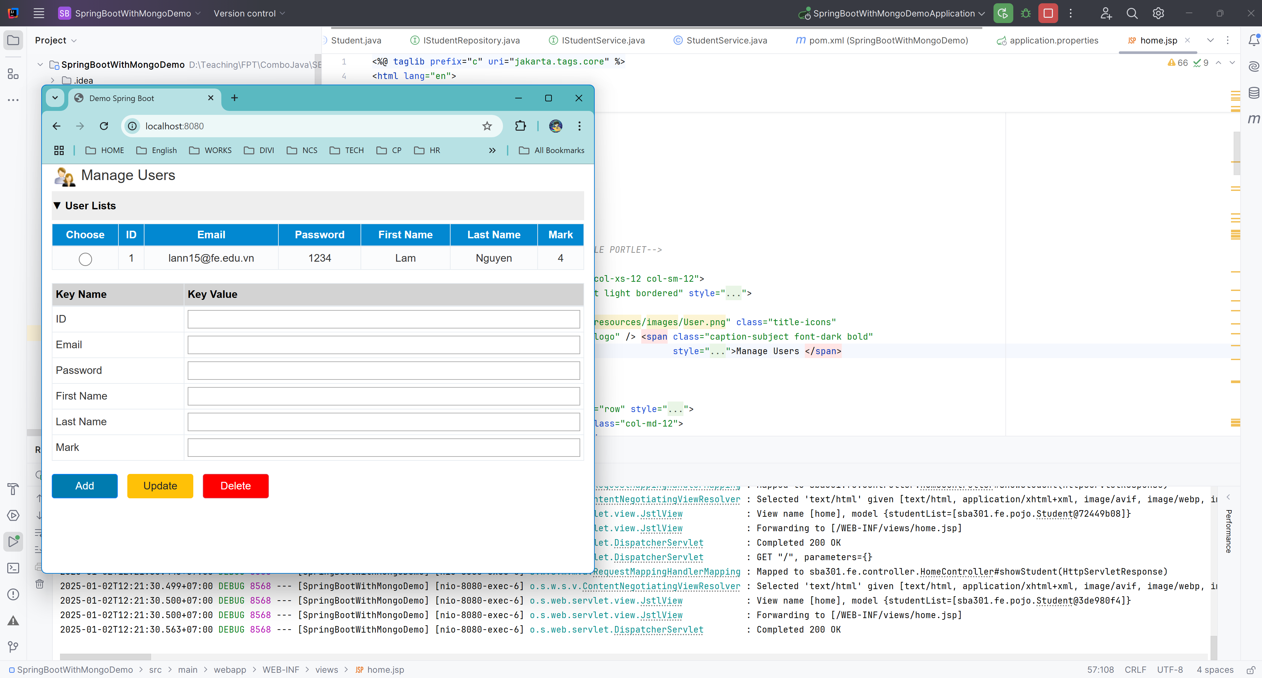
Automatic Restart

Slide 26
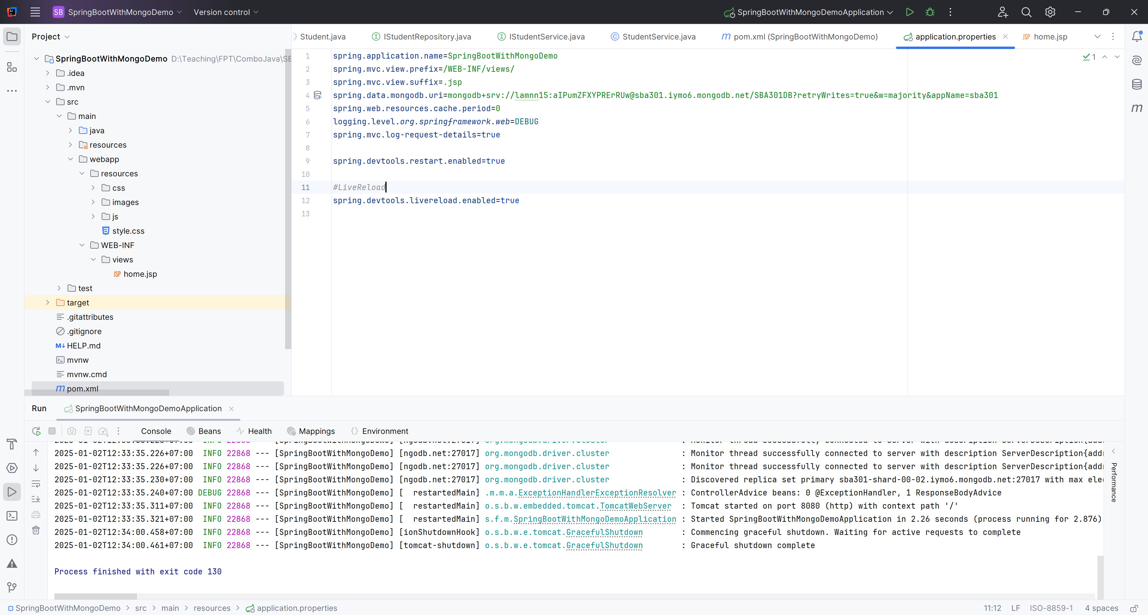
Config LiveReload

Slide 27
Summary
Concepts were introduced:
DevOps
Spring Boot with DevOps
DevOps Tools for Spring Boot

